Slide 1
Linear Regression
Dr. A. Emamzadeh

Slide 2






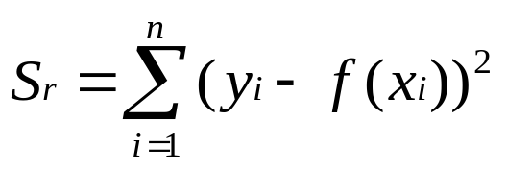

What is Regression?
What is regression? Given n data points
best fit
to the data. The best fit is generally based on
minimizing the sum of the square of the residuals,
.
Residual at a point is
Sum of the square of the residuals
Figure. Basic model for regression

Slide 3









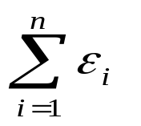

Linear Regression-Criterion#1
Given n data points
best fit
to the data.
y
Figure. Linear regression of y vs. x data showing residuals at a typical point, x_{i} .
x
Does minimizing
work as a criterion, where

Slide 4
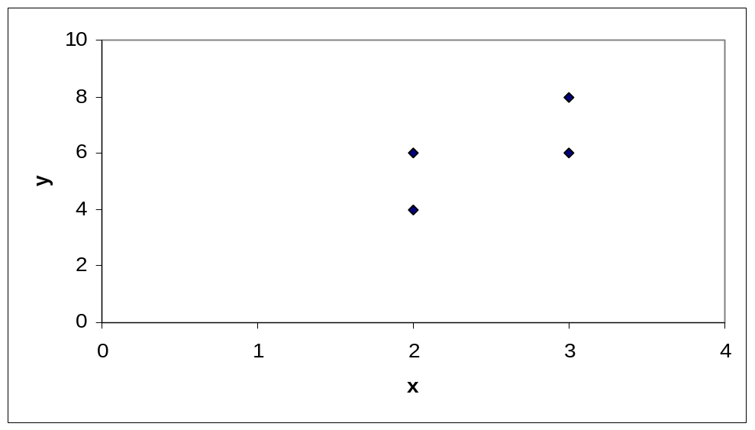
Example for Criterion#1
Example: Given the data points (2,4), (3,6), (2,6) and (3,8), best fit the data to a straight line using Criterion#1
Table. Data Points
x | y
2.0 | 4.0
3.0 | 6.0
2.0 | 6.0
3.0 | 8.0
Figure. Data points for y vs. x data.

Slide 5
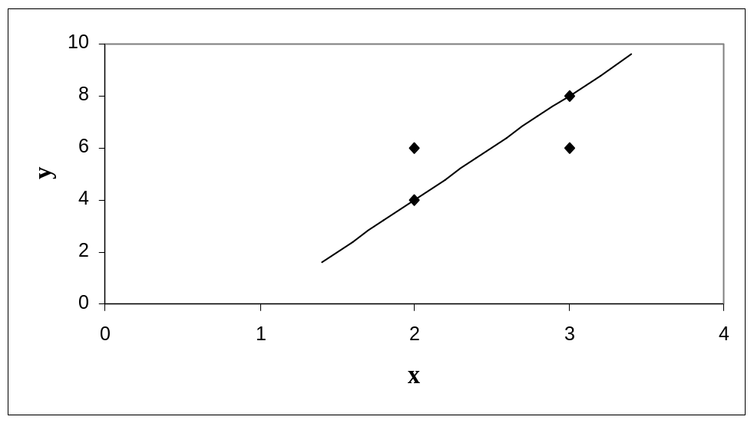
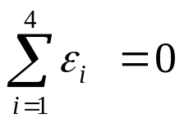
Linear Regression-Criteria#1
Using y=4x-4 as the regression curve
Table. Residuals at each point for regression model y = 4x – 4.
x | y | y_{predicted} | ε = y - y_{predicted}
2.0 | 4.0 | 4.0 | 0.0
3.0 | 6.0 | 8.0 | -2.0
2.0 | 6.0 | 4.0 | 2.0
3.0 | 8.0 | 8.0 | 0.0
Figure. Regression curve for y=4x-4, y vs. x data

Slide 6
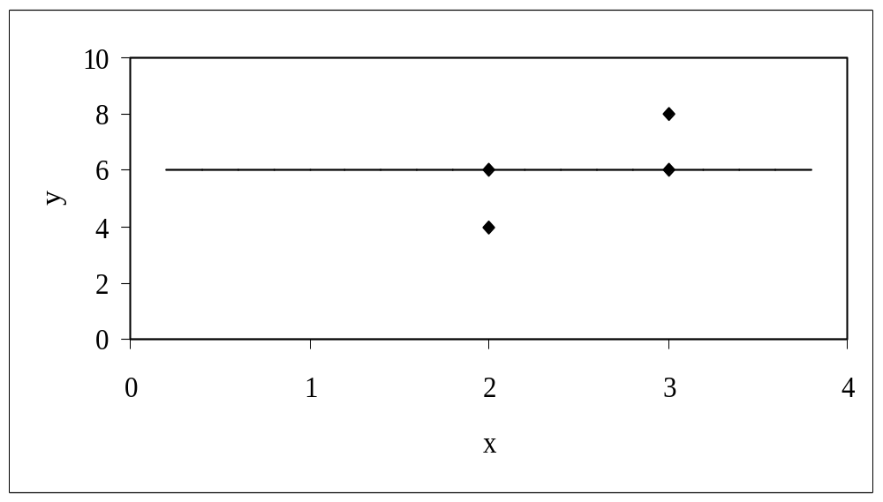
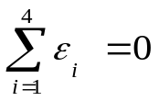
Linear Regression-Criteria#1
Using y=6 as a regression curve
Table. Residuals at each point for y=6
x | y | y_{predicted} | ε = y - y_{predicted}
2.0 | 4.0 | 6.0 | -2.0
3.0 | 6.0 | 6.0 | 0.0
2.0 | 6.0 | 6.0 | 0.0
3.0 | 8.0 | 6.0 | 2.0
Figure. Regression curve for y=6, y vs. x data

Slide 7
Linear Regression – Criterion #1
for both regression models of y=4x-4 and y=6.
The sum of the residuals is as small as possible, that is zero, but the regression model is not unique.
Hence the above criterion of minimizing the sum of the residuals is a bad criterion.

Slide 8
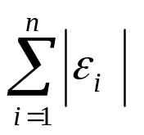
Linear Regression-Criterion#2
Will minimizing
work any better?
y
x
Figure. Linear regression of y vs. x data showing residuals at a typical point, x_{i} .

Slide 9
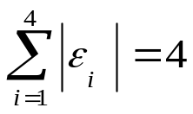
Linear Regression-Criteria 2
Using y=4x-4 as the regression curve
Table. The absolute residuals employing the y=4x-4 regression model
x | y | y_{predicted} | |ε| = |y - y_{predicted}|
2.0 | 4.0 | 4.0 | 0.0
3.0 | 6.0 | 8.0 | 2.0
2.0 | 6.0 | 4.0 | 2.0
3.0 | 8.0 | 8.0 | 0.0
Figure. Regression curve for y=4x-4, y vs. x data

Slide 10
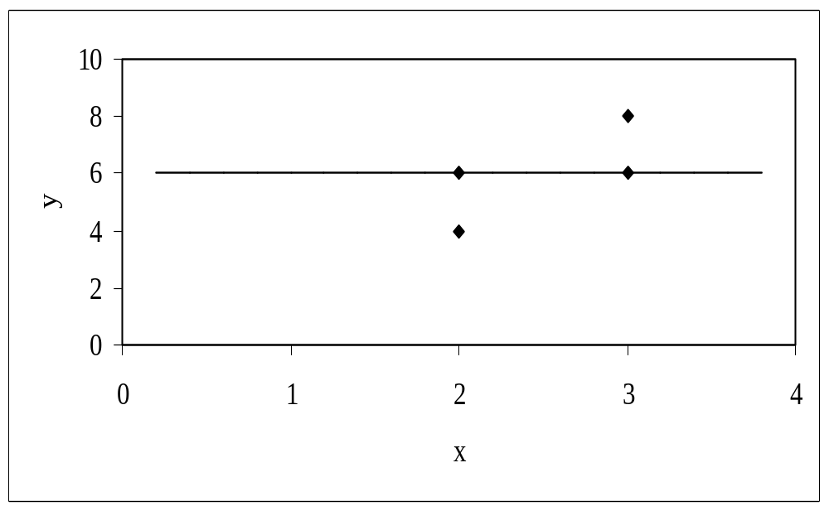
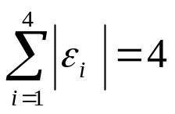
Linear Regression-Criteria#2
Using y=6 as a regression curve
Table. Absolute residuals employing the y=6 model
x | y | y_{predicted} | |ε| = |y – y_{predicted}|
2.0 | 4.0 | 6.0 | 2.0
3.0 | 6.0 | 6.0 | 0.0
2.0 | 6.0 | 6.0 | 0.0
3.0 | 8.0 | 6.0 | 2.0
Figure. Regression curve for y=6, y vs. x data

Slide 11
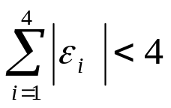
Linear Regression-Criterion#2
for both regression models of y=4x-4 and y=6.
The sum of the errors has been made as small as possible, that is 4, but the regression model is not unique.
Hence the above criterion of minimizing the sum of the absolute value of the residuals is also a bad criterion.
Can you find a regression line for which
and has unique
regression coefficients?

Slide 12
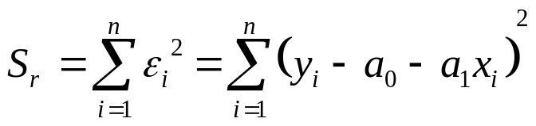
Least Squares Criterion
The least squares criterion minimizes the sum of the square of the residuals in the model, and also produces a unique line.
y
x
Figure. Linear regression of y vs. x data showing residuals at a typical point, x_{i} .

Slide 13



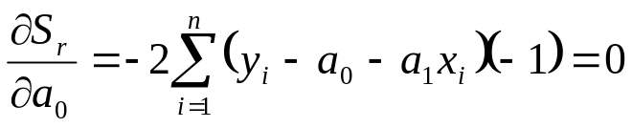
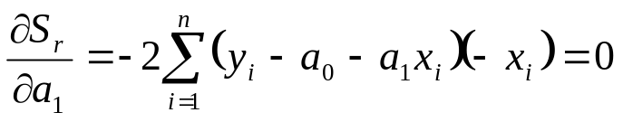
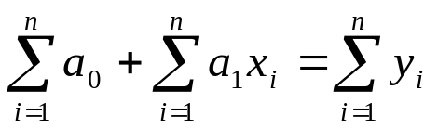

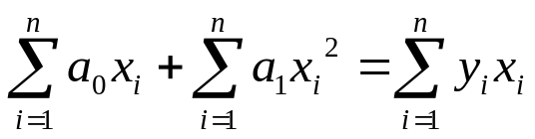
Finding Constants of Linear Model
Minimize the sum of the square of the residuals:
To find
and
we minimize
with respect to
and
.
giving

Slide 14

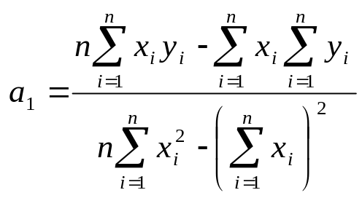
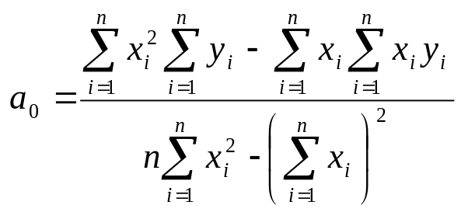

Finding Constants of Linear Model
Solving for
and
directly yields,
and

Slide 15

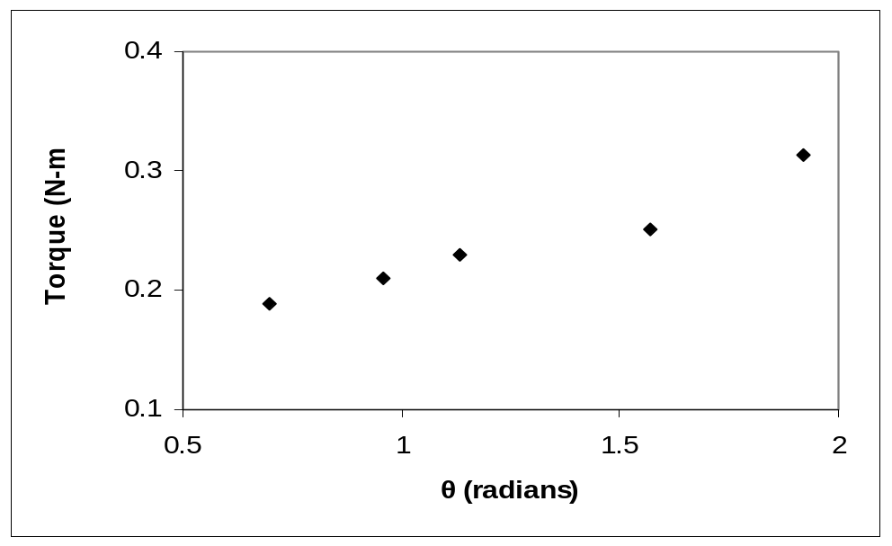
Example 1
The torque, T needed to turn the torsion spring of a mousetrap through an angle, is given below.
Find the constants for the model given by
Table: Torque vs Angle for a torsional spring
Angle, θ | Torque, T
Radians | N-m
0.698132 | 0.188224
0.959931 | 0.209138
1.134464 | 0.230052
1.570796 | 0.250965
1.919862 | 0.313707
Figure. Data points for Angle vs. Torque data

Slide 16





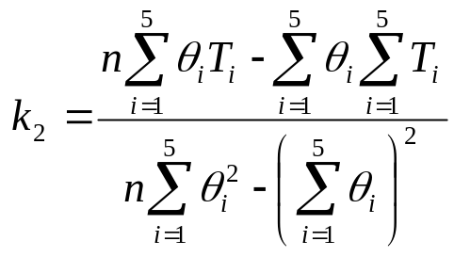
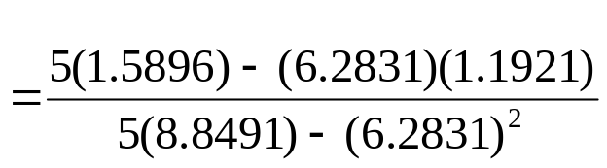
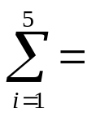

Example 1 cont.
The following table shows the summations needed for the calculations of the constants in the regression model.
Table. Tabulation of data for calculation of important
summations
Radians | N-m | Radians² | N-m-Radians
0.698132 | 0.188224 | 0.487388 | 0.131405
0.959931 | 0.209138 | 0.921468 | 0.200758
1.134464 | 0.230052 | 1.2870 | 0.260986
1.570796 | 0.250965 | 2.4674 | 0.394215
1.919862 | 0.313707 | 3.6859 | 0.602274
6.2831 | 1.1921 | 8.8491 | 1.5896
Using equations described for
and
with
N-m/rad

Slide 17

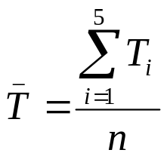
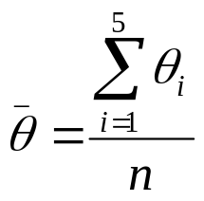
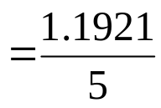
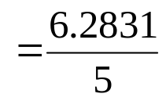


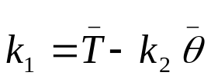

Example 1 cont.
Use the average torque and average angle to calculate
Using,
N-m

Slide 18
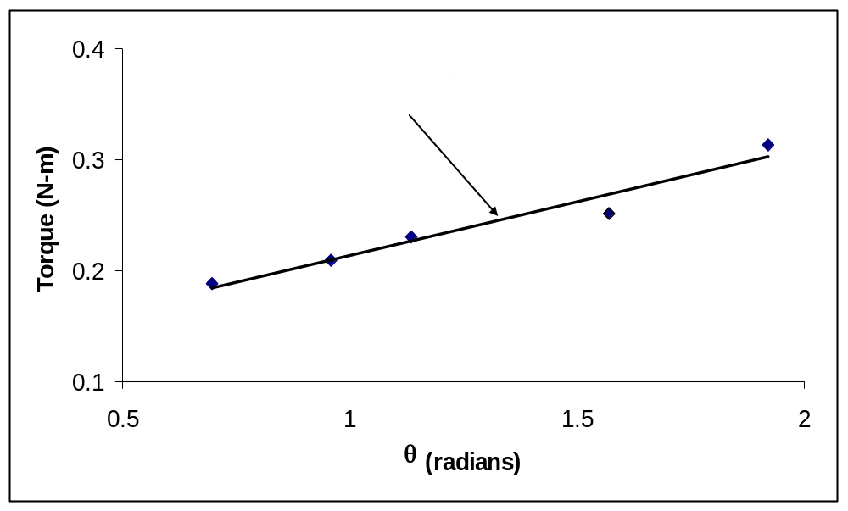
Example 1 Results
Using linear regression, a trend line is found from the data
Figure. Linear regression of Torque versus Angle data
Can you find the energy in the spring if it is twisted from 0 to 180 degrees?

Slide 19


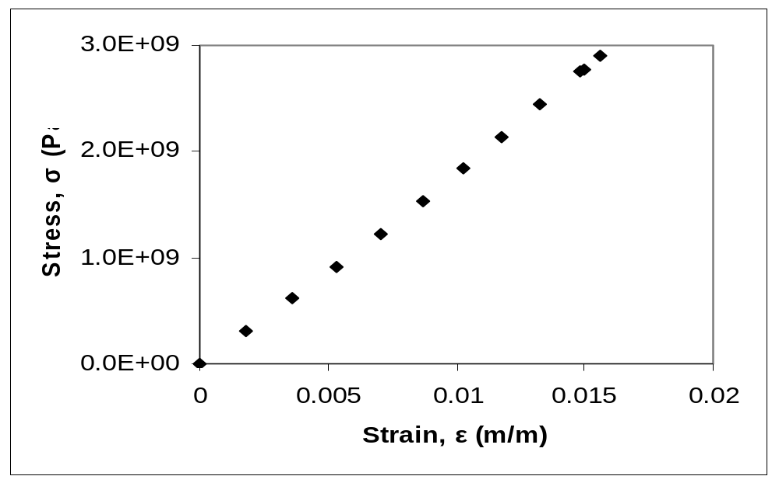
Example 2
To find the longitudinal modulus of composite, the following data is collected. Find the longitudinal modulus,
using the regression model
Table. Stress vs. Strain data
and the sum of the square of the
Strain | Stress
(%) | (MPa)
0 | 0
0.183 | 306
0.36 | 612
0.5324 | 917
0.702 | 1223
0.867 | 1529
1.0244 | 1835
1.1774 | 2140
1.329 | 2446
1.479 | 2752
1.5 | 2767
1.56 | 2896
residuals.
Figure. Data points for Stress vs. Strain data

Slide 20

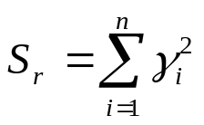
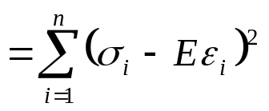

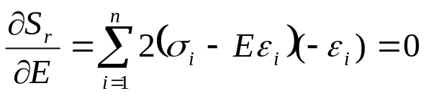
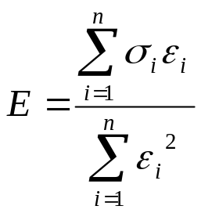
Example 2 cont.
Residual at each point is given by
The sum of the square of the residuals then is
Differentiate with respect to
Therefore

Slide 21
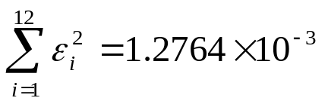
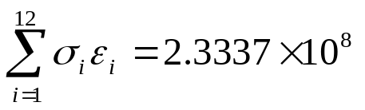
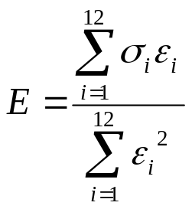
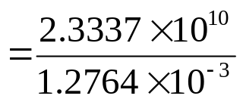


Example 2 cont.
Table. Summation data for regression model
With
i | ε | σ | ε ² | εσ
1 | 0.0000 | 0.0000 | 0.0000 | 0.0000
2 | 1.8300x10⁻³ | 3.0600x10⁸ | 3.3489x10⁻⁶ | 5.5998x10⁵
3 | 3.6000x10⁻³ | 6.1200x10⁸ | 1.2960x10⁻⁵ | 2.2032x10⁶
4 | 5.3240x10⁻³ | 9.1700x10⁸ | 2.8345x10⁻⁵ | 4.8821x10⁶
5 | 7.0200x10⁻³ | 1.2230x10⁹ | 4.9280x10⁻⁵ | 8.5855x10⁶
6 | 8.6700x10⁻³ | 1.5290x10⁹ | 7.5169x10⁻⁵ | 1.3256x10⁷
7 | 1.0244x10⁻² | 1.8350x10⁹ | 1.0494x10⁻⁴ | 1.8798x10⁷
8 | 1.1774x10⁻² | 2.1400x10⁹ | 1.3863x10⁻⁴ | 2.5196x10⁷
9 | 1.3290x10⁻² | 2.4460x10⁹ | 1.7662x10⁻⁴ | 3.2507x10⁷
10 | 1.4790x10⁻² | 2.7520x10⁹ | 2.1874x10⁻⁴ | 4.0702x10⁷
11 | 1.5000x10⁻² | 2.7670x10⁹ | 2.2500x10⁻⁴ | 4.1505x10⁷
12 | 1.5600x10⁻² | 2.8960x10⁹ | 2.4336x10⁻⁴ | 4.5178x10⁷
 |  |  | 1.2764x10⁻³ | 2.3337x10⁸
and
Using

Slide 22

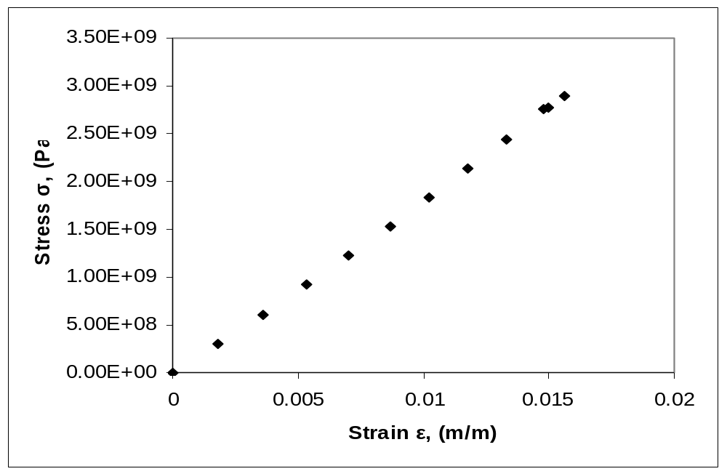
Example 2 Results
The equation
describes the data.
Figure. Linear regression for Stress vs. Strain data

Slide 23
Nonlinear Regression
Dr. A. Emamzadeh

Slide 24








Nonlinear Regression
Given n data points
best fit
to the data, where
is a nonlinear function of
.
Figure. Nonlinear regression model for discrete y vs. x data

Slide 25


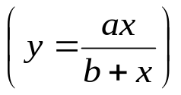

Nonlinear Regression
Some popular nonlinear regression models:
1. Exponential model:
2. Power model:
3. Saturation growth model:
4. Polynomial model:

Slide 26


Exponential Model
Given
best fit
to the data.
Figure. Exponential model of nonlinear regression for y vs. x data

Slide 27
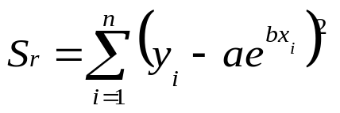


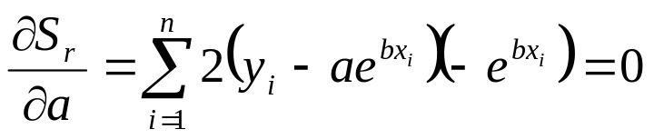
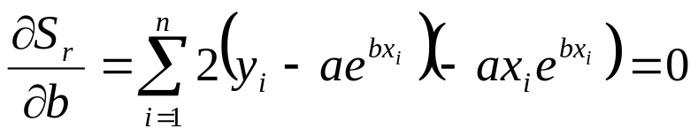
Finding constants of Exponential Model
The sum of the square of the residuals is defined as
Differentiate with respect to
and

Slide 28
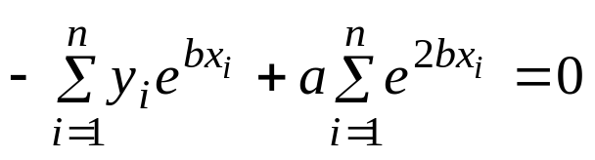
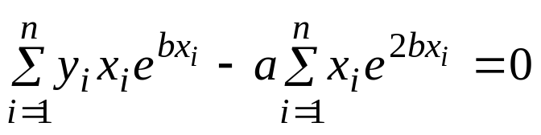
Finding constants of Exponential Model
Rewriting the equations, we obtain

Slide 29
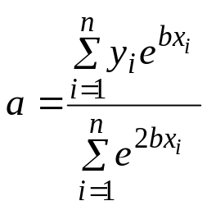

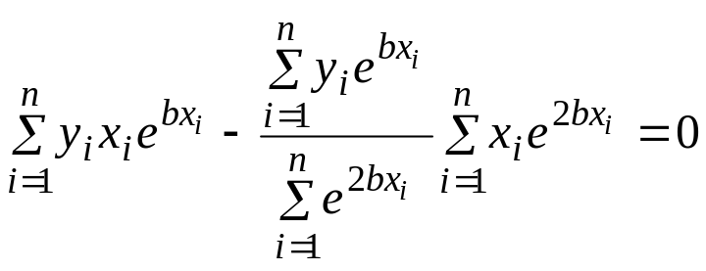

Finding constants of Exponential Model
Solving the first equation for
yields
Substituting
back into the previous equation
Nonlinear equation in terms of
The constant
can be found through numerical methods such
as the bisection method or secant method.

Slide 30
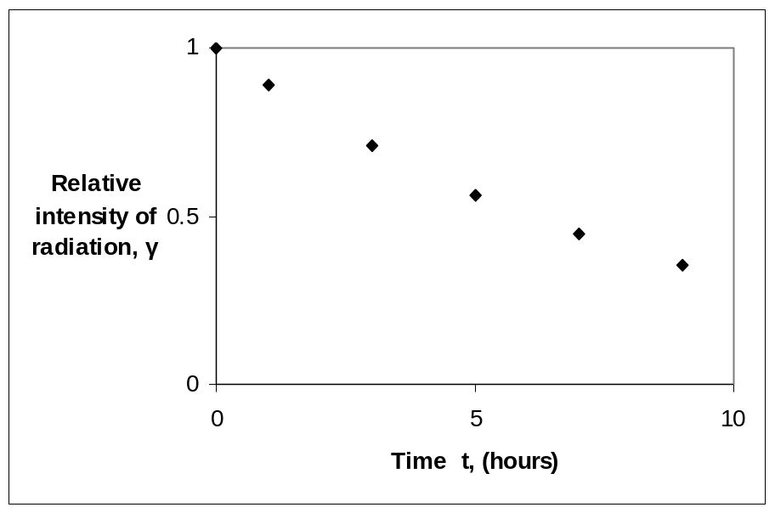

Example 1-Exponential Model
Many patients get concerned when a test involves injection of a radioactive material. For example for scanning a gallbladder, a few drops of Technetium-99m isotope is used. Half of the techritium-99m would be gone in about 6 hours. It, however, takes about 24 hours for the radiation levels to reach what we are exposed to in day-to-day activities. Below is given the relative intensity of radiation as a function of time.
Table. Relative intensity of radiation as a function
of time
t(hrs) | 0 | 1 | 3 | 5 | 7 | 9
 | 1.000 | 0.892 | 0.708 | 0.562 | 0.447 | 0.355
Figure. Data points of relative radiation intensity vs. time

Slide 31



Example 1-Exponential Model cont.
Find:
a) The value of the regression constants
and
b) The half-life of Technium-99m
c) Radiation intensity after 24 hours
The relative intensity is related to time by the equation

Slide 32

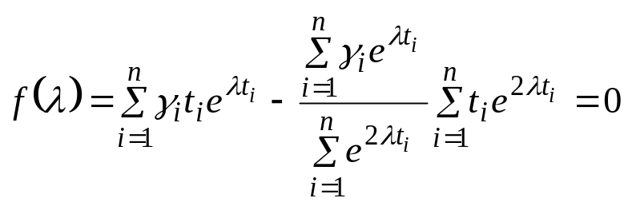

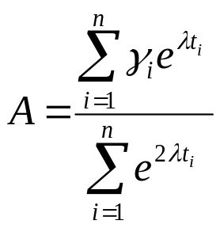
Example 1-Exponential Model cont.
The value for
is found by solving the nonlinear equation
Numerical methods such as bisection method, or secant method are the best method to solve for
The value for
is then found by solving

Slide 33











Example 1-Exponential Model cont.
Using bisection method, we may estimate the initial bracket for
to be
The table below shows
evaluated at
.
Table. Summation value for calculation of constants of model
1 2 3 4 5 6 | 0 1 3 5 7 9 | 1 0.891 0.708 0.562 0.447 0.355 | 0.00000 0.70719 1.0620 0.88509 0.62087 0.39937 | 1.00000 0.70719 0.35400 0.17702 0.08870 0.04437 | 1.00000 0.62996 0.25000 0.09921 0.03937 0.01562 | 0.00000 0.62996 0.75000 0.49606 0.27560 0.14062
 |  |  | 3.6745 | 2.3713 | 2.0342 | 2.2922

Slide 34






Example 1-Exponential Model cont.
From Table,

Slide 35







Example 1-Exponential Model cont.
Using the same procedure with
we find
Since
the value of
falls in
the bracket
Continuing the bisection method, we eventually find that the root of
is
.
This was calculated after twenty iterations with an absolute relative approximate error of 0.0002%.

Slide 36





Example 1-Exponential Model cont.
The value
can now be calculated
The exponential regression model then is

Slide 37


Example 1-Exponential Model cont.
Resulting model
Figure. Relative intensity of radiation as a function of time
using an exponential regression model.

Slide 38





Example 1-Exponential Model cont.
b) Half life of Technetium 99-m is when
c) The relative intensity of radiation after 24 hours
This result implies that only
of the initial
radioactive intensity is left after 24 hours.

Slide 39



Polynomial Model
Given
best fit
to a given data set.
Figure. Polynomial model for nonlinear regression of y vs. x data

Slide 40


Polynomial Model cont.
The residual at each data point is given by
The sum of the square of the residuals then is

Slide 41



Polynomial Model cont.
To find the constants of the polynomial model, we set the derivatives with respect to
where
equal to zero.

Slide 42


Polynomial Model cont.
These equations in matrix form are given by
The above equations are then solved for

Slide 43


Example 2-Polynomial Model
Regress the thermal expansion coefficient vs. temperature data to a second order polynomial.
Table. Data points for temperature vs
Temperature, T (ºF) | Coefficient of thermal expansion, α (in/in/ºF)
80 | 6.47x10⁻⁶
40 | 6.24x10⁻⁶
-40 | 5.72x10⁻⁶
-120 | 5.09x10⁻⁶
-200 | 4.30x10⁻⁶
-280 | 3.33x10⁻⁶
-340 | 2.45x10⁻⁶
Figure. Data points for thermal expansion coefficient vs temperature.

Slide 44



Example 2-Polynomial Model cont.
We are to fit the data to the polynomial regression model
The coefficients
are found by differentiating the sum of the
square of the residuals with respect to each variable and setting the
values equal to zero to obtain

Slide 45






Example 2-Polynomial Model cont.
The necessary summations are as follows
Table. Data points for temperature vs.
Temperature, T (ºF) | Coefficient of thermal expansion, α (in/in/ºF)
80 | 6.47x10⁻⁶
40 | 6.24x10⁻⁶
-40 | 5.72x10⁻⁶
-120 | 5.09x10⁻⁶
-200 | 4.30x10⁻⁶
-280 | 3.33x10⁻⁶
-340 | 2.45x10⁻⁶

Slide 46



Example 2-Polynomial Model cont.
Using these summations, we can now calculate
Solving the above system of simultaneous linear equations we have
The polynomial regression model is then

Slide 47







Linearization of Data
To find the constants of many nonlinear models, it results in solving simultaneous nonlinear equations. For mathematical convenience, some of the data for such models can be linearized. For example, the data for an exponential model can be linearized.
As shown in the previous example, many chemical and physical processes are governed by the equation,
Taking the natural log of both sides yields,
Let
and
We now have a linear regression model where
(implying)
with

Slide 48



Linearization of data cont.
Using linear model regression methods,
Once
are found, the original constants of the model are found as

Slide 49
Example 3-Linearization of data
Many patients get concerned when a test involves injection of a radioactive material. For example for scanning a gallbladder, a few drops of Technetium-99m isotope is used. Half of the techritium-99m would be gone in about 6 hours. It, however, takes about 24 hours for the radiation levels to reach what we are exposed to in day-to-day activities. Below is given the relative intensity of radiation as a function of time.
Table. Relative intensity of radiation as a function
of time
t(hrs) | 0 | 1 | 3 | 5 | 7 | 9
 | 1.000 | 0.892 | 0.708 | 0.562 | 0.447 | 0.355
Figure. Data points of relative radiation intensity vs. time

Slide 50
Example 3-Linearization of data cont.
Find:
a) The value of the regression constants
and
b) The half-life of Technium-99m
c) Radiation intensity after 24 hours
The relative intensity is related to time by the equation

Slide 51








Example 3-Linearization of data cont.
Exponential model given as,
Assuming
,
and
we obtain
This is a linear relationship between
and

Slide 52





Example 3-Linearization of data cont.
Using this linear relationship, we can calculate
where
and

Slide 53












Example 3-Linearization of Data cont.
Summations for data linearization are as follows
With
Table. Summation data for linearization of data model
1 2 3 4 5 6 | 0 1 3 5 7 9 | 1 0.891 0.708 0.562 0.447 0.355 | 0.00000 -0.11541 -0.34531 -0.57625 -0.80520 -1.0356 | 0.0000 -0.11541 -1.0359 -2.8813 -5.6364 -9.3207 | 0.0000 1.0000 9.0000 25.000 49.000 81.000
 | 25.000 |  | -2.8778 | -18.990 | 165.00

Slide 54









Example 3-Linearization of Data cont.
Calculating
Since
also

Slide 55

Example 3-Linearization of Data cont.
Resulting model is
Figure. Relative intensity of radiation as a function of temperature using linearization of data model.

Slide 56

Example 3-Linearization of Data cont.
The regression formula is then
b) Half life of Technetium 99 is when

Slide 57



Example 3-Linearization of Data cont.
c) The relative intensity of radiation after 24 hours is then
This implies that only
of the radioactive
material is left after 24 hours.

Slide 58
Comparison
Comparison of exponential model with and without data linearization:
Table. Comparison for exponential model with and without data linearization.
 | With data linearization (Example 3) | Without data linearization (Example 1)
A | 0.99974 | 0.99983
λ | -0.11505 | -0.11508
Half-Life (hrs) | 6.0247 | 6.0232
Relative intensity after 2 hrs. | 6.3160x10⁻² | 6.3200x10⁻²
The values are very similar so data linearization was suitable to find the constants of the nonlinear exponential model in this case.

